Slide 1
Law Enforcement Information Exchange (LInX) NC CJIN Board Update October 5, 2017 Frank Palombo, New Bern Chief of Police (Retired) NCIS LInX Carolinas Program Manager

Slide 2
LInX Record Type Percentages
Over 1 Billion Event Records
Over 90 Million Mugshots
Over 800 Million Narratives

Slide 3
LInX Carolinas Coverage Map 2008
City/County Interface
NC State Interfaces (NCSHP / NC SBI)

Slide 4
LInX Carolinas Coverage Map 2015
Pending MOU Completion
City/County Interface
NC State Interfaces (NCSHP / NC SBI)

Slide 5
LInX Carolinas Coverage Map Today
Grant Funds Approved
City/County Interface
NC State Interfaces (NCSHP / NC SBI)

Slide 6
LInX Carolinas Coverage Map Sept 2018
City/County Interface
NC State Interfaces (NCSHP / NC SBI)

Slide 7
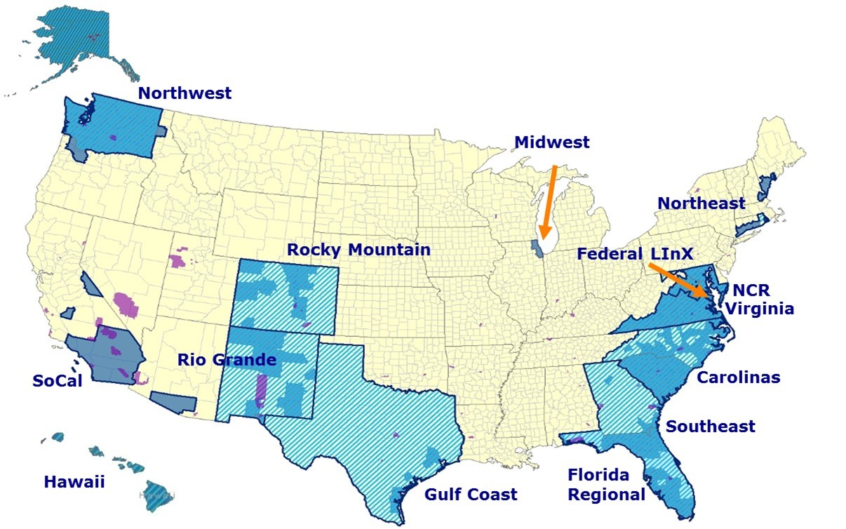
Regional LInX Systems

Slide 8
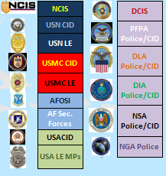
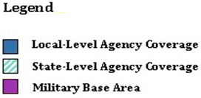
LInX/D-Dex Systems

Slide 9
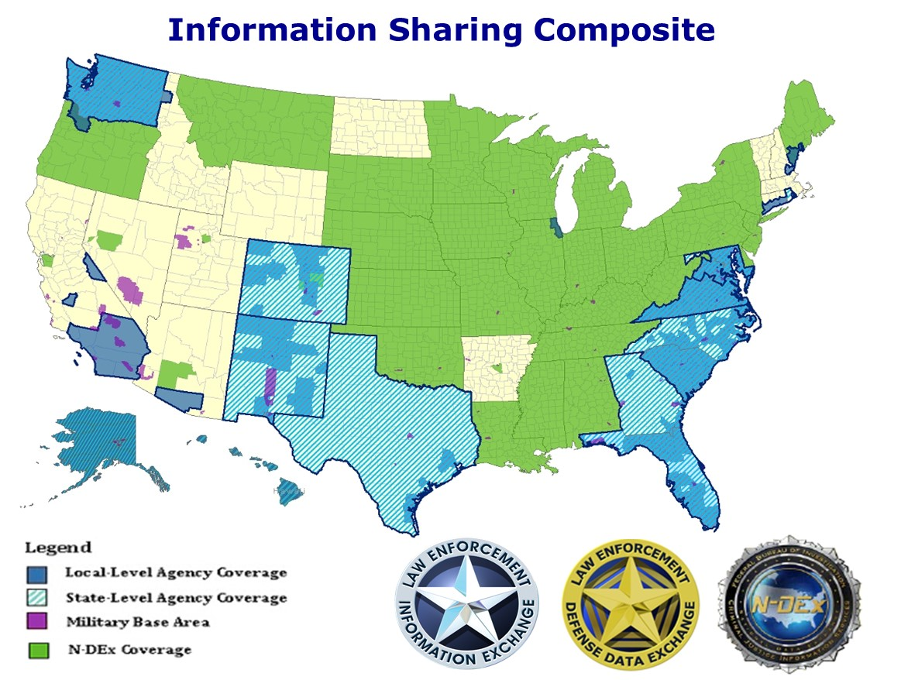

Slide 10
LInX Carolinas
Current Status:
LInX Carolinas users now have access to law enforcement records from over 1900 agencies system wide including 13 LInX Regions, the FED Region, DDEX and N-DEX
From May 2008 to-date, the total cost to NC taxpayers for LInX Carolinas, has been $401,474
During that time, 100% of the LInX Carolinas annual operating and maintenance costs have been paid by the Naval Criminal Investigative Service (NCIS). Funding for FY 2018 is beyond our expectations. Future funding beyond 2018 is likely. However, all funding projections are subject to future appropriations
During the past 36 months, LInX Carolinas has added approx. 200 agencies and now hosts 286 NC agencies and 210 SC agencies

Slide 11
LInX Carolinas
Current Status (Continued):
During the past 24 months, LInX Carolinas has added approx. 200 agencies and now hosts 286 NC agencies, 210 SC agencies, 5 federal agencies and all of the Dept. of Defense LE agencies
The NC General Assembly’s appropriation of $288,474 for the expansion of LInX has contributed to the current increase by adding 46 agencies
The commitment of funds by the GA has allowed LInX to grow to cover an additional 1,591,554 (15.94%) of NC’s population and an additional 5,071 (18.87%) of her officers. This brings LInX NC population coverage to an astounding 8,663,223 (84%) and sworn officers with the ability to access LInX to 21,446 (79%). That project is now complete
NCIS is funded Task Order 31 and Task Order 33 adding 10 and 4 new agencies respectively to LInX. These projects are now complete

Slide 12
CRISS COPS Grant Modification
We are currently working on the CMPD COPS grant modification that made a substantial amount of money available to expand LInX participation mostly in the western part of the state
The funds provide mapping for approximately 62 agencies. When this phase of expansion is complete LInX will cover approximately 89% of NC’s population (9.2 million) and 84% of our sworn officers (23,000). This project is 86% complete
By this time next year we anticipate LInX will be hosting nearly 300 NC law enforcement member agencies sharing data

Slide 13
LInX Coverage in NC To-Date
Total NC Population - 10,424,515
Population Covered by LInX Agencies - 9,089,247 – 87.19%
Population Not Covered by LInX Agencies - 1,335,271 – 12.81%
Total NC Sworn Officers - 27,459
Sworn Officers Covered By LInX Agencies - 22,755 - 82.87%
Sworn Officers Not Covered by LInX Agencies - 4,704 - 17.13%

Slide 14
LInX Moving Forward
Continue to acquire funding for the expansion of LInX to all NC law enforcement agencies
Bring LInX to all NC State LE Agencies
Add DMV, NC AWARE, CJ LEADS and other NC data bases to the LInX single sign-on capability
Work with the General Assembly to establish a state-wide second hand goods data base that would be available through LInX

Slide 15
Questions or additional information:
NCIS LInX Carolinas Program Manager
Frank Palombo, Chief of Police,
New Bern Police Department (Retired)
(252) 626-1765 mobile
palombo1@twc.com

